Slide 1
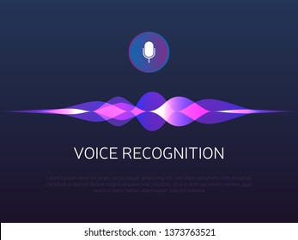
INTERACTIVE VOICE RECOGNITION
FOR FORM FILLING AND REGISTRATION FOR VISUALLY CHALLENGED

Slide 2
PRESENTED BY
GANDHAMATHAN V – 20CSR051
MITHUN m – 20CSR120
DARSHAN S – 20CSR036
KONGU ENGINEERING COLLEGE

Slide 3

INTRODUCTION
Responding to form by voice recoginition automatically

Slide 4
Problem Statement
In this Digitalized world we all are moving from paper pens to online forms. This development is on a track with cloud computing and everything in registration and information needed is gone with online forms. Which makes it difficult for the visually challenged. On olden registration for visually challenged there is a method known as braille system. In this system the word are uses combinations of raised dots to spell letters and numbers and they can understand and can fill the required informations. But The main difficulty in filling forms online is finding the need of the form and giving the correct information in the accurate position and if he/she is filling the correct answer.

Slide 5



Problem
Finding
Filling
Correctness
Finding what’s the requirments of the form
Filling the correct answer in the correct position
Once it is filled the correctness of the answers

Slide 6
Solution Statement
As for Visually challenged, there are some developed softwares for reading text and voice assistants like alexa,cortana,ok google etc… Voice is the best and versatile method for visually challenged people. So we decided to get the required information by using voice recognition and fit it into the correct place automatically and submit it.

Slide 7
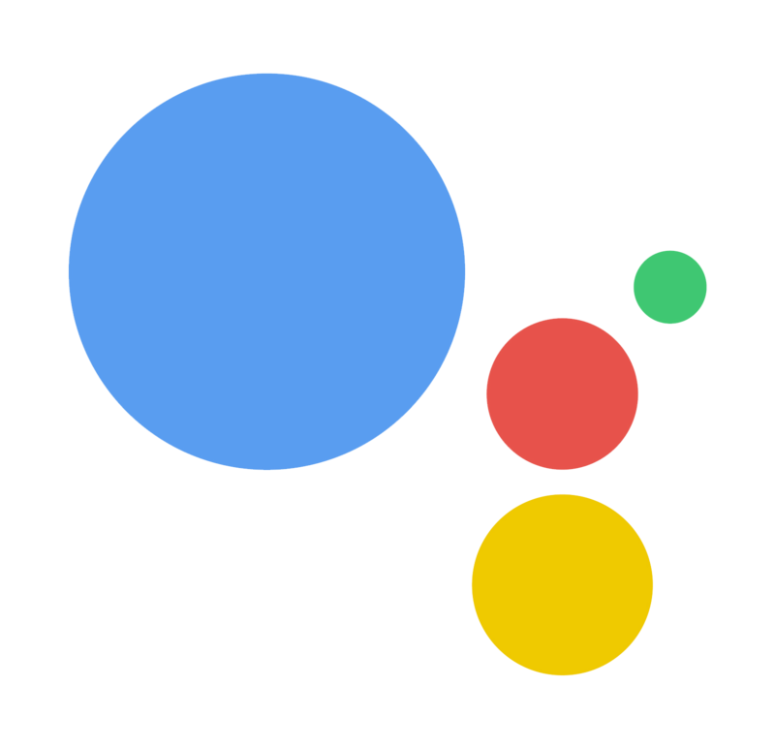



Existing Systems
Ok Google
Alexa
There are some voice assistant software that helps people in many ways on natural language. Which plays a vital role in daily routine.
Siri
Cortana

Slide 8
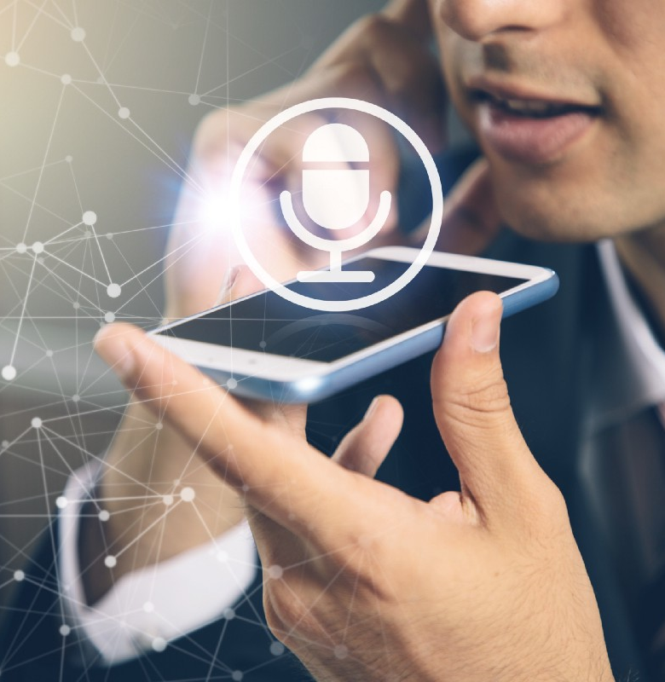
Proposed System
In this project we have used python packages for voice recognition for getting the required inputs , web browser handler that used for handling the correct field and set the received inputs , automatic form submitting function.
And further it can be used for filling some other applications like sheets , keep notes, etc,..

Slide 9
DEMO

Slide 10
Thank YOU

